Slide 1
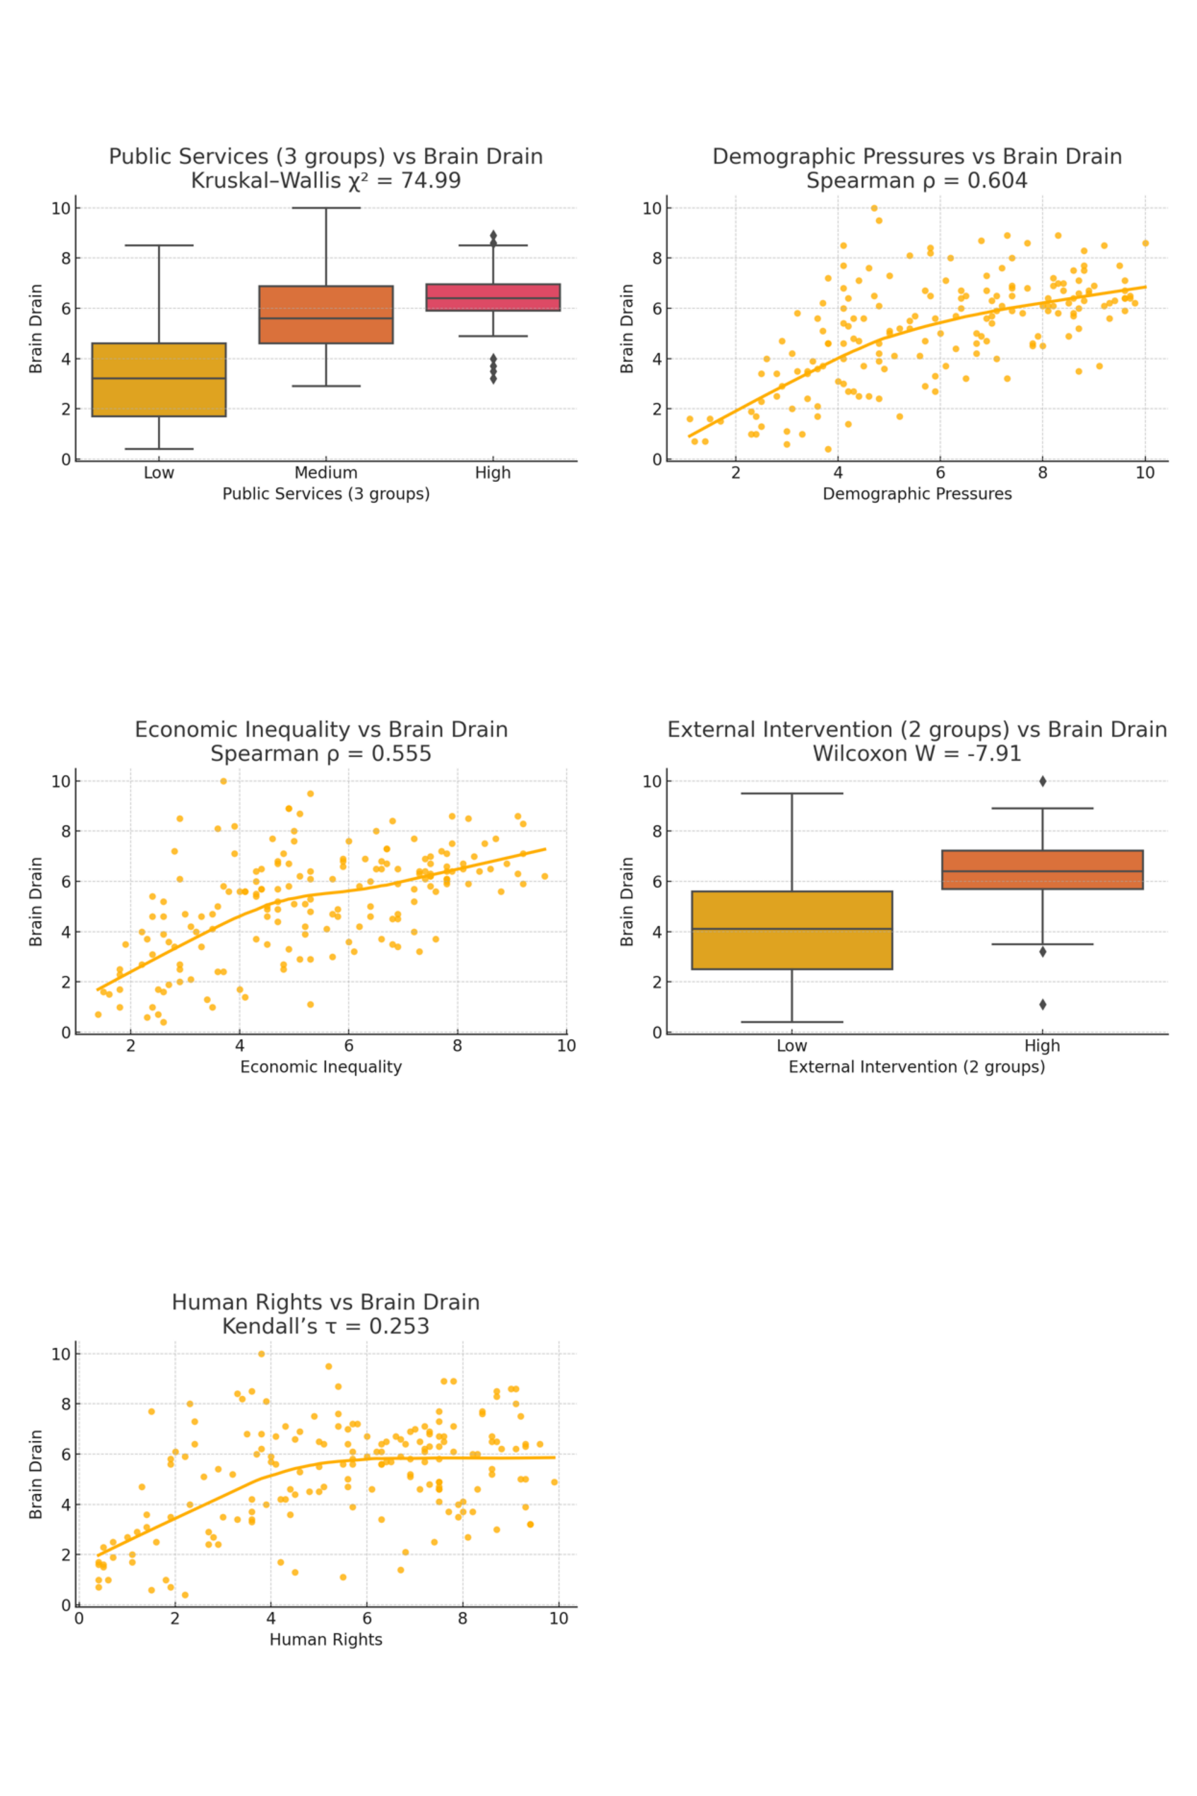
Immigration Patterns and Pressures: A Multivariate Non-Parametric Approach
University Of Applied Science Mittweida
Romina Emadi
OBJECTIVES
Results1
Results2
The project focuses on analyzing international emigration tendencies (measured by Brain Drain scores) and the socio-economic and political factors behind them. The objective is to identify patterns and statistical associations between key national indicators and the level of emigration across countries.
Five plots were generated using ggplot2 in R to visually demonstrate the relationships:
Economic Inequality vs Brain Drain: Spearman ρ = 0.55, p < 0.001→ Positive mo notonic relationship.
Demographic Pressures vs Brain Drain: Spearman ρ = 0.60, p < 0.001→ Positive monotonic relationship.
Public Services Group vs Brain Drain: Kruskal–Wallis χ² = 75.03, p < 0.001→ Significant differences among groups.
External Intervention vs Brain Drain: Wilcoxon W = -7.91, p < 0.001→ High vs. low intervention groups differ significantly.
Human Rights vs Brain Drain: Kendall’s τ = 0.253, p < 0.001→ Weak but statistically significant positive monotonic relationship.
The table summarizes the results of five statistical tests conducted to analyze the relationship between brain drain (emigration) and various socio-economic and political factors. Each row corresponds to a specific statistical test and includes the following information:
Variable 1:
The independent variable being analyzed for its potential influence on emigration rates.
Test Type :
The type of statistical test used to examine the relationship :
Spearman correlation and Kendall’s tau assess monotonic (non-linear) relationships.
Kruskal–Wallis compares distributions across multiple groups.
Wilcoxon rank-sum test compares two independent groups.
H₀ (Null Hypothesis):
Assumes there is no relationship between the variables or no difference between groups.
H₁ (Alternative Hypothesis):
Suggests there is a relationship between the variables or that group differences exist.
Test Statistic:
The numeric value obtained from the test (e.g., ρ, τ, W, or χ²) used to determine significance.
p-value:
The probability of observing the result (or more extreme) if the null hypothesis is true. A p-value less than 0.05 indicates statistical significance.
Decision:
Based on the p-value: if it is less than 0.05, the null hypothesis is rejected, meaning the result is statistically significant.
INTRODUCTION
This study aims to investigate the socio-economic and political drivers of immigration across different countries. By analyzing indicators such as economic inequality, demographic pressures, public services, human rights, and external intervention, we seek to determine how these variables are statistically associated with immigration trends.
MATHERIAL AND Methodology
Approach: Quantitative and exploratory analysis using Brain Drain as a proxy for emigration.
Data: Cross-sectional scores (0–10) for ~100 countries on:
Economic Inequality
Demographic Pressures
Public Services
Human Rights
External Intervention
Brain Drain (dependent)
Grouping:
Public Services: Low / Medium / High
External Intervention: Low / High (median split)
Methods:
Spearman Correlation
Kruskal–Wallis Test
Wilcoxon Test
Kendall’s tau test
Visuals: Boxplots & Scatter plots
Tools: R (v4.4.3), with readxl, ggplot2, dplyr
Justification: Non-parametric tests chosen for ordinal data and robustness to non-normality.
📌 All tests were statistically significant at α = 0.05.
Test No. | Variable 1 | Test | H0 (Null Hypothesis) | H1 (Alternative Hypothesis) | Test Statistic | p-value | Decision (α = 0.05)
1 | Economic Inequality | Spearman | No monotonic relationship | Monotonic relationship exists | S = 0.555 | 7.98e-16 | Reject H₀
2 | Demographic Pressures | Spearman | No monotonic relationship | Monotonic relationship exists | S = 0.604 | < 2.2e-16 | Reject H₀
3 | Public Services | Kruskal-Wallis | All groups have equal distribution | At least one group differs | Chi-sq = 74.99 | < 2.2e-16 | Reject H₀
4 | External Intervention | Wilcoxon | Distributions are the same | Distributions are different | W = -7.91 | 2.54e-15 | Reject H₀
5 | Human Rights | Kendall | No monotonic relationship | Monotonic relationship exists | τ = 0.253 | 6.95e-07 | Reject H₀
Conclusion
DISCUTION
The analysis identifies strong monotonic associations between Brain Drain and key socio-political factors: Economic Inequality (ρ = 0.55), Demographic Pressures (ρ = 0.60), and Human Rights (τ = 0.253) all show statistically significant positive correlations (p < 0.001).
Significant distributional differences in Brain Drain were also found:
across Public Services groups (Kruskal–Wallis χ² = 75.03, p < 0.001)
between External Intervention levels (Wilcoxon W = 6728.5, p < 0.001)
These results suggest that socio-economic hardship, limited rights, and weak governance are major drivers of emigration.
Non-parametric methods — including Spearman’s rho, Kendall’s tau, Kruskal–Wallis, and Wilcoxon tests — were chosen due to the ordinal nature and non-normal distribution of the international indicators.
However, as the data are cross-sectional, the findings reflect associations rather than causal relationships. To confirm causality, future studies should use longitudinal data.
The analysis shows that countries with higher inequality, demographic pressures, and poor human rights tend to face greater Brain Drain. Non-parametric tests confirmed that high public services and high external intervention are linked to higher emigration.
These findings suggest that both socio-economic conditions and governance quality play key roles in migration decisions. However, due to the cross-sectional data, we cannot claim causality. Further studies with longitudinal data are needed.
Refrence
https://www.migrationdataportal.org/

